Slide 1

Decision Tree Classifier
Dr.Manju Venugopalan
Department of Computer Science & Engineering,
Amrita School of Engineering, Bengaluru
1

Slide 2
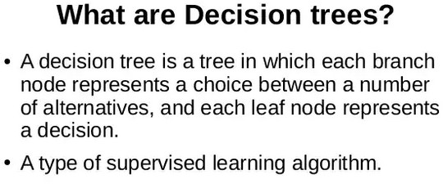

Slide 3
Decision Tree An Example
Employed?
No
Yes
Credit score
Income
Whether to approve/reject a loan application?
high low
high
low
approve
reject
approve
reject

Slide 4
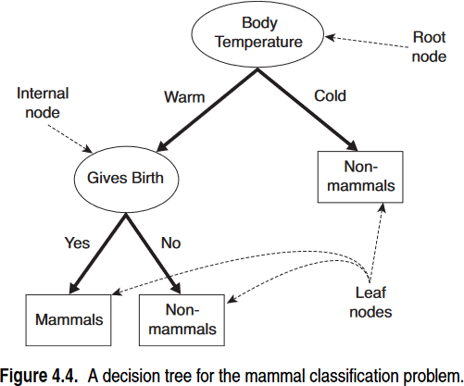

Class = Non-Mammals

Slide 5

Numerical attribute

Slide 6
age?
<=30
31..40
>40
Buys computer/not?
student?
yes
credit rating?
no
yes
excellent fair
no
yes
yes

Slide 7
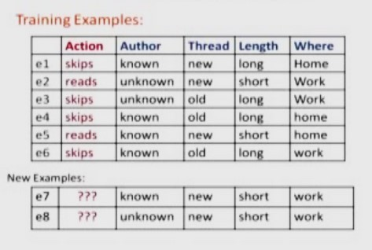
Example data

Slide 8
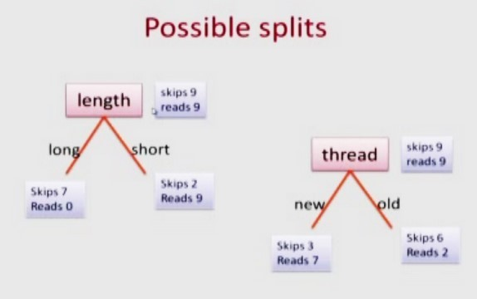

Slide 9
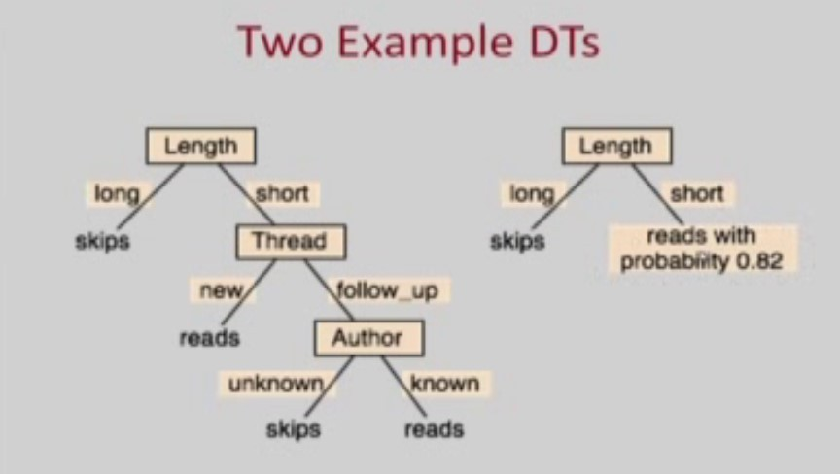

Slide 10
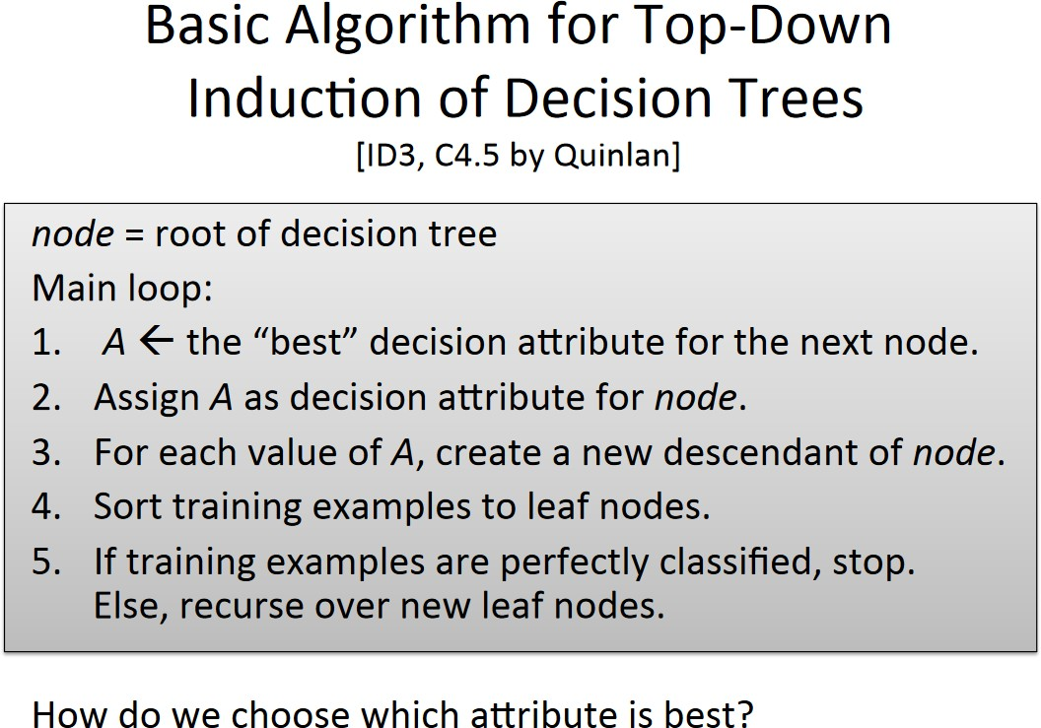

Slide 11
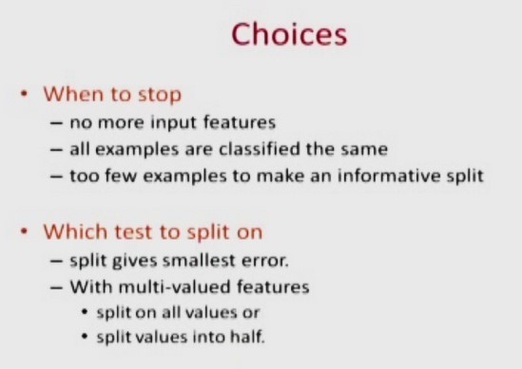

Slide 12
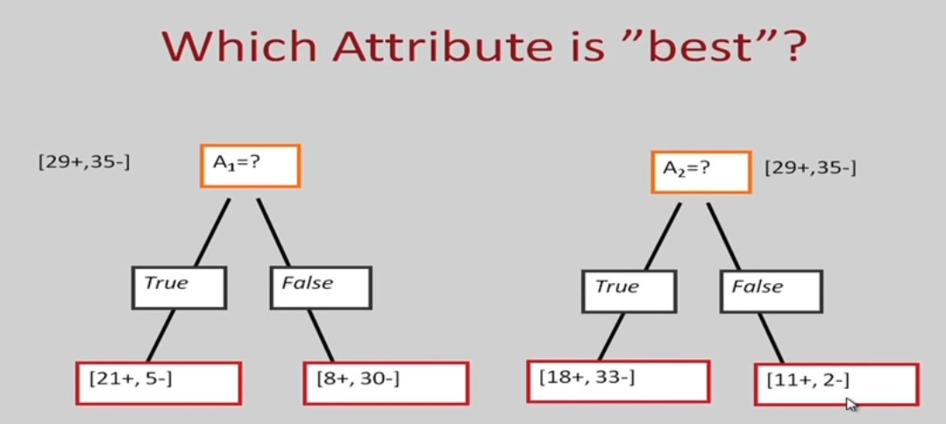

Slide 13
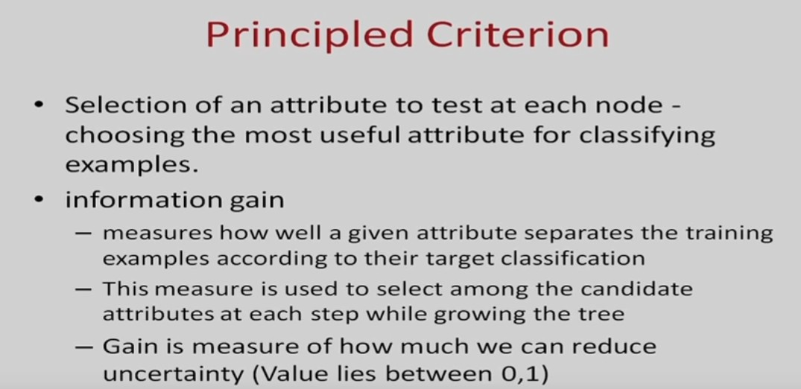

Slide 14
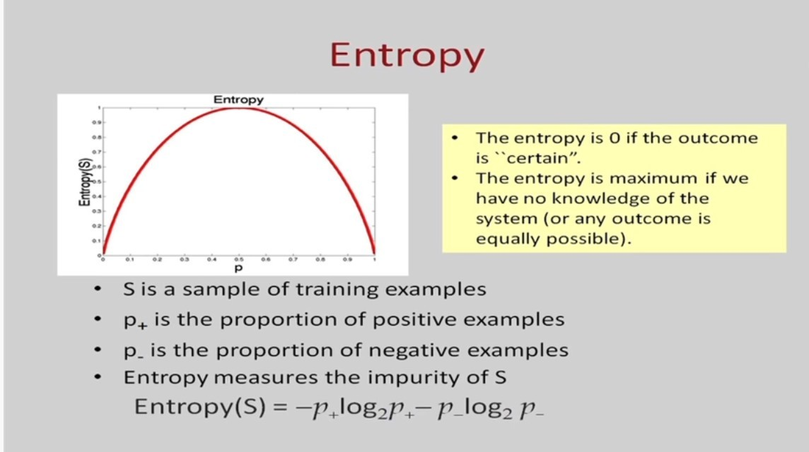

Slide 15
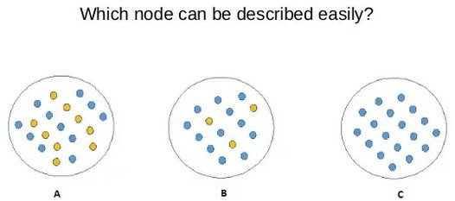
How to choose best decision node

Slide 16
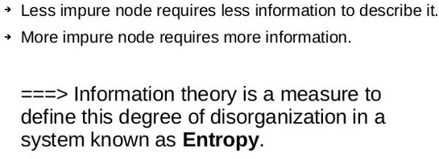

Slide 17
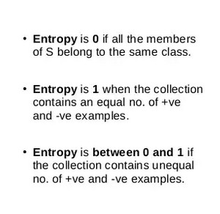
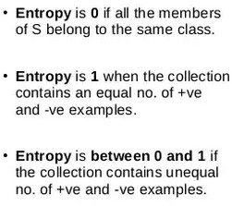

Slide 18
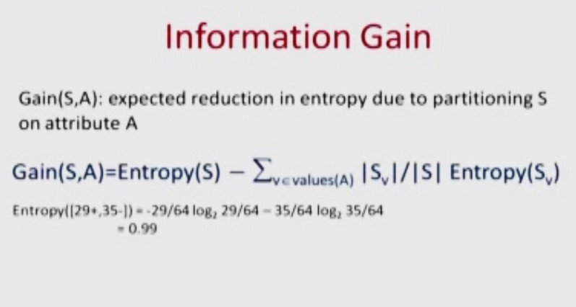

Slide 19
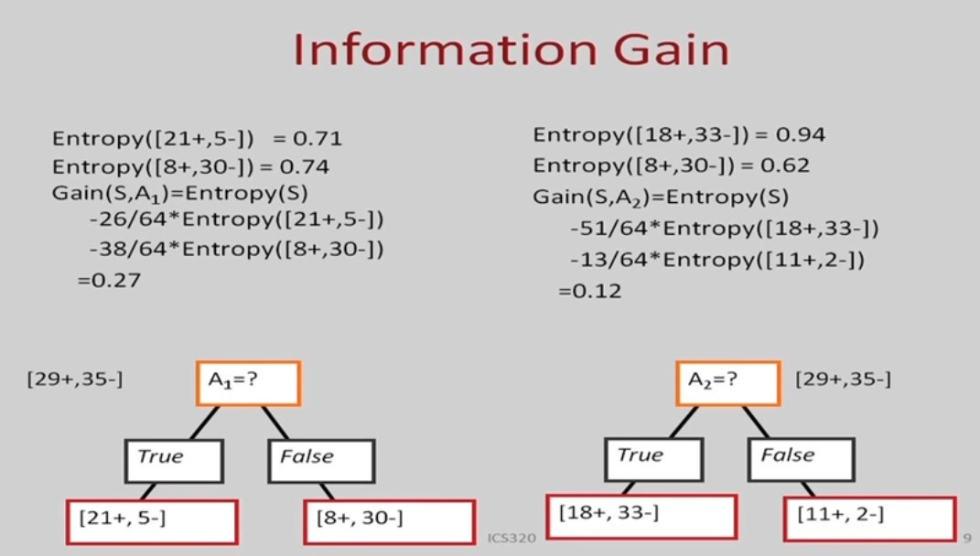

Slide 20
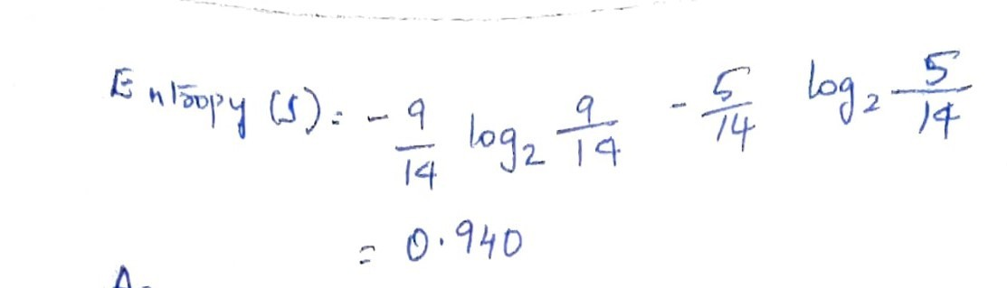

Example
age | income | student | credit_rating | buys_computer
<=30 | high | no | fair | no
<=30 | high | no | excellent | no
31…40 | high | no | fair | yes
>40 | medium | no | fair | yes
>40 | low | yes | fair | yes
>40 | low | yes | excellent | no
31…40 | low | yes | excellent | yes
<=30 | medium | no | fair | no
<=30 | low | yes | fair | yes
>40 | medium | yes | fair | yes
<=30 | medium | yes | excellent | yes
31…40 | medium | no | excellent | yes
31…40 | high | yes | fair | yes
>40 | medium | no | excellent | no
Class P: buys_computer = “yes”
Class N: buys_computer = “no”

Slide 21
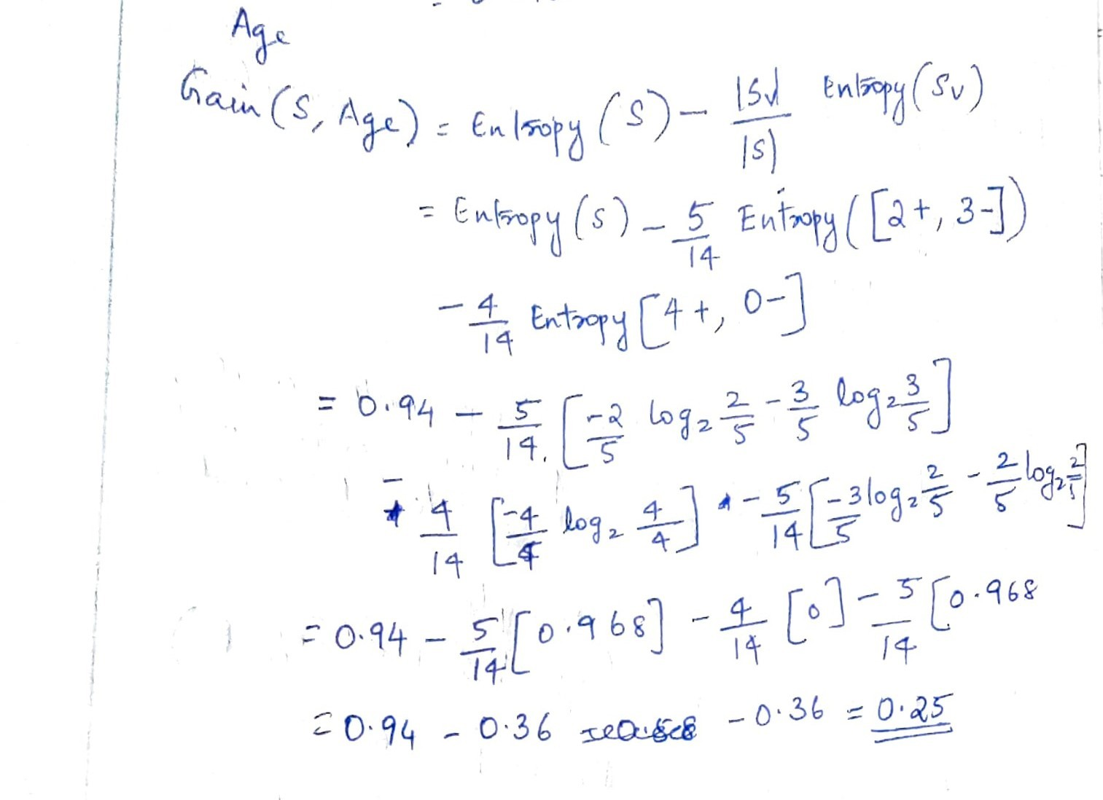

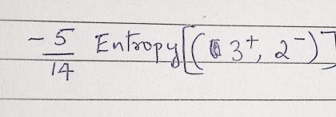


Slide 22
𝐺𝑎𝑖𝑛 𝑎𝑔𝑒 = 0.25
𝐺𝑎𝑖𝑛(𝑖𝑛𝑐𝑜𝑚𝑒) = 0.029
𝐺𝑎𝑖𝑛(𝑠𝑡𝑢𝑑𝑒𝑛𝑡) = 0.151
𝐺𝑎𝑖𝑛(𝑐𝑟𝑒𝑑𝑖𝑡_𝑟𝑎𝑡𝑖𝑛𝑔) = 0.048
Age has maximum information gain. So age is selected as the best node to split . So age is selected as root node

Slide 23
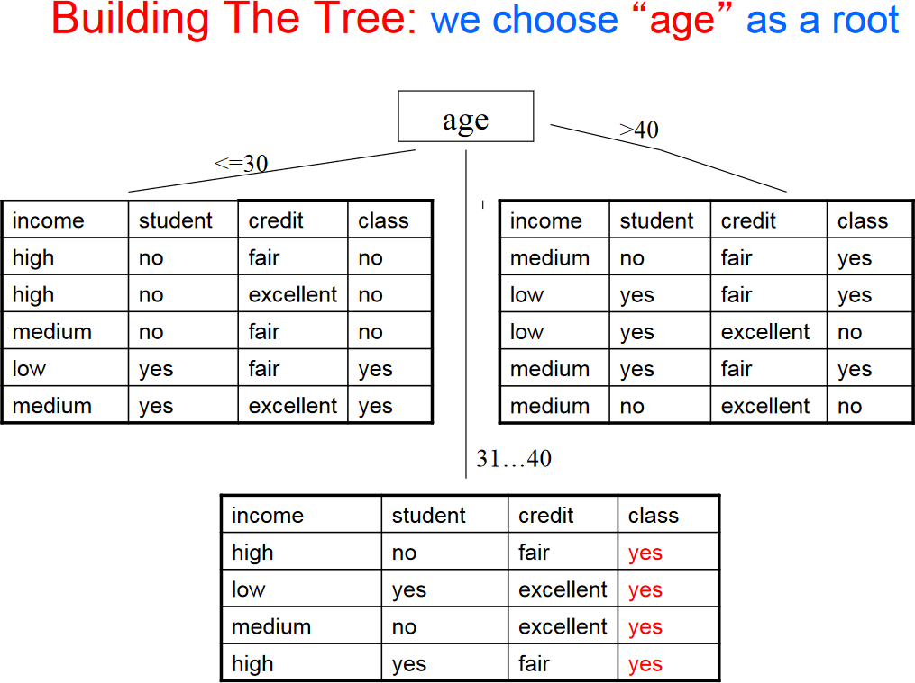

Slide 24
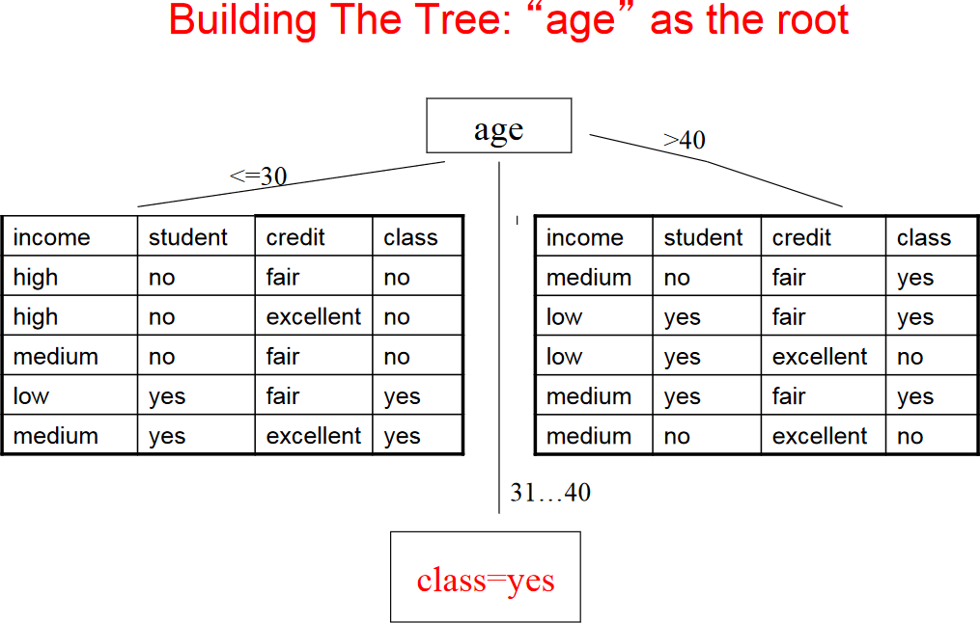

Slide 25
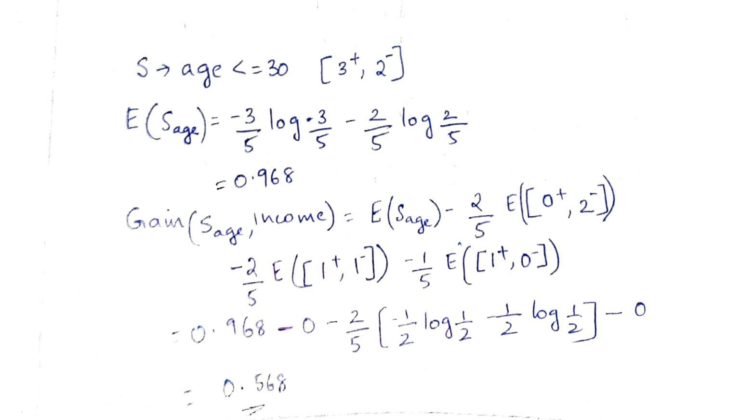
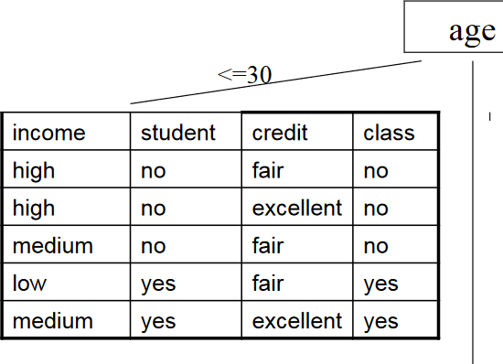


Slide 26
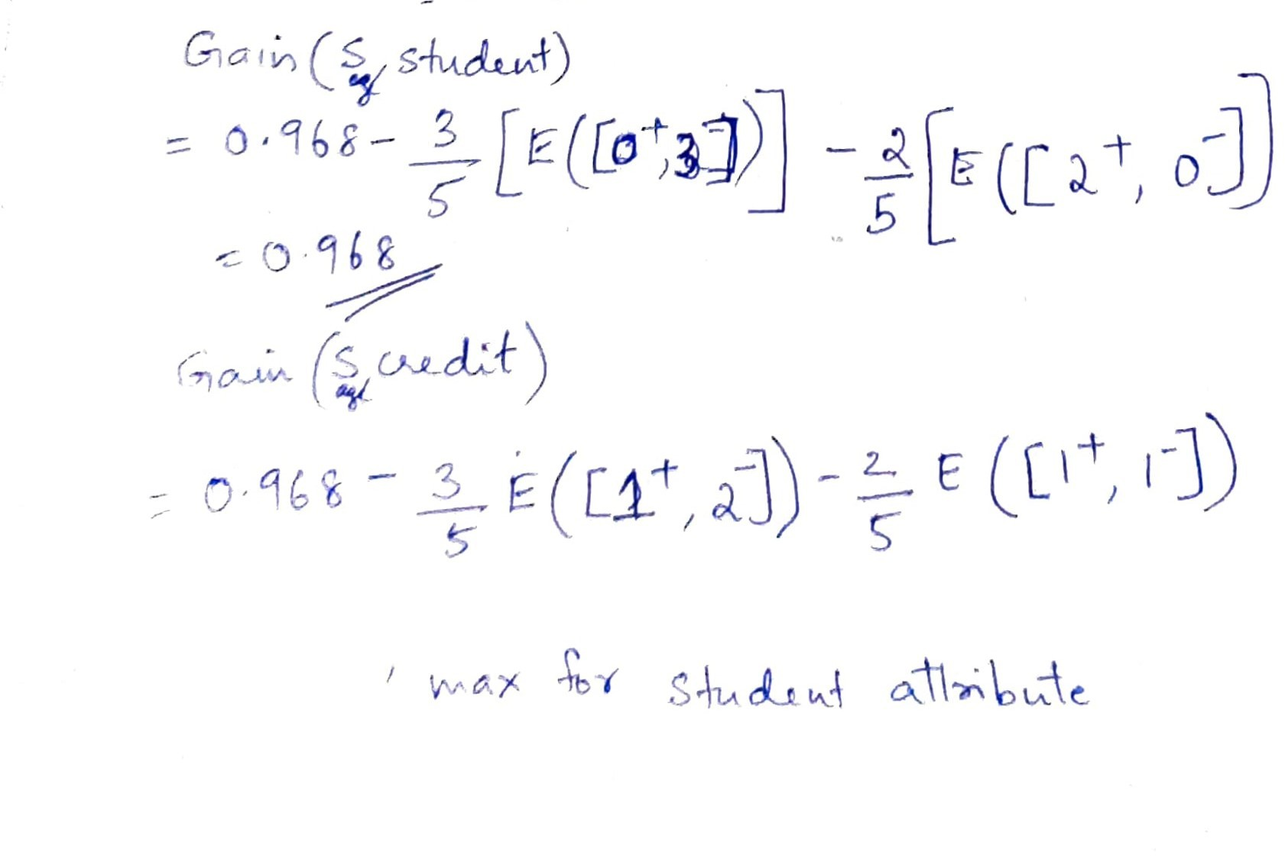
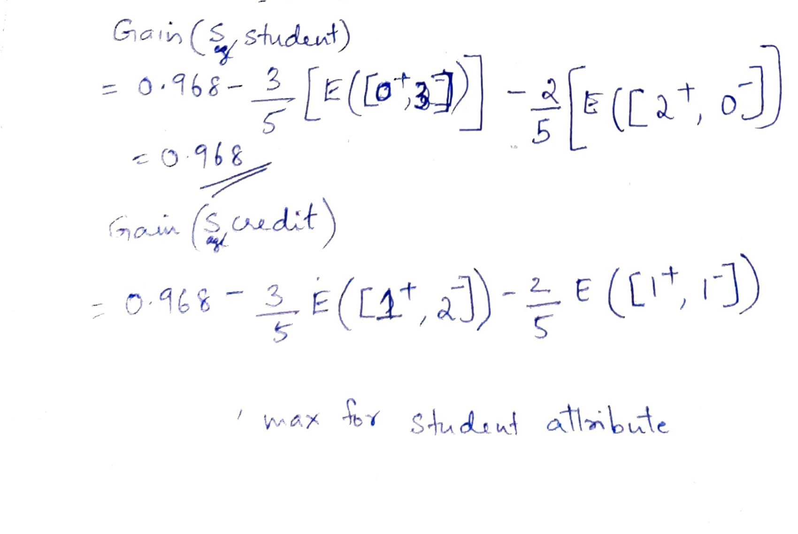

Slide 27
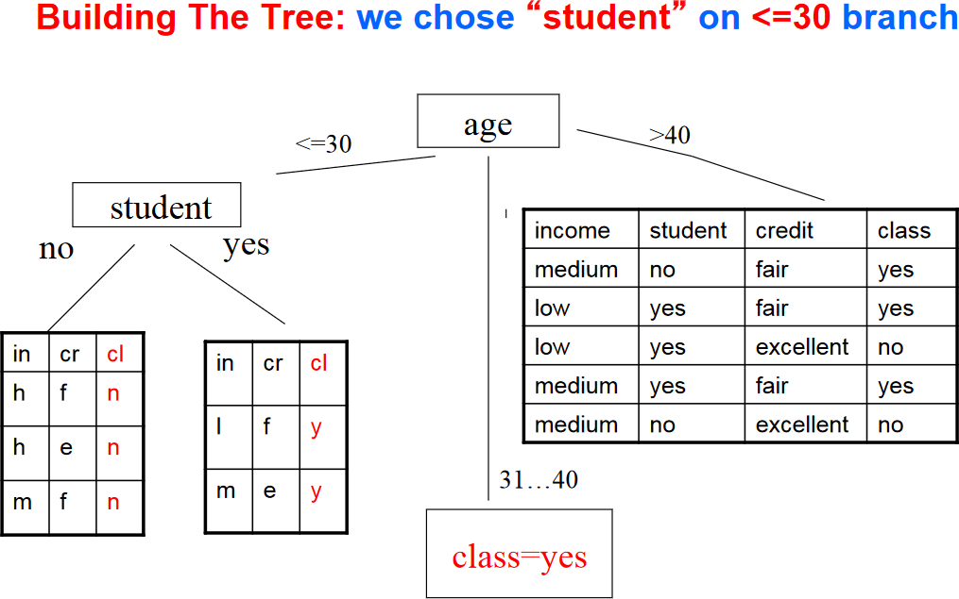

Slide 28
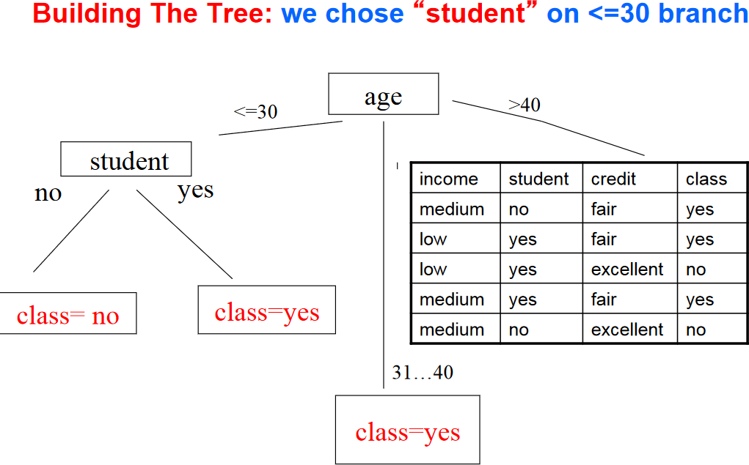

Slide 29
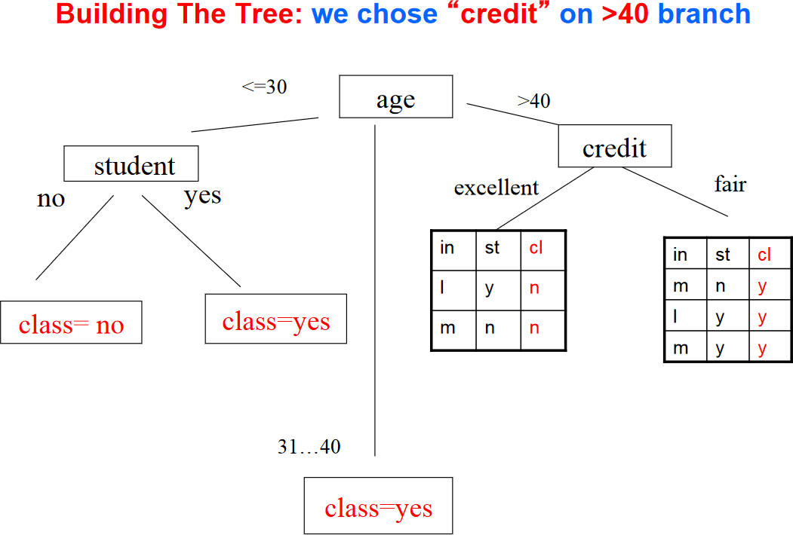

Slide 30
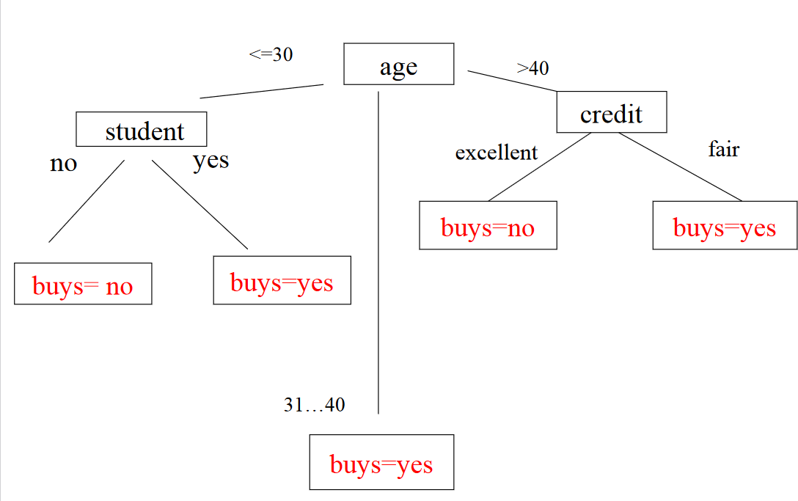
Final tree

Slide 31
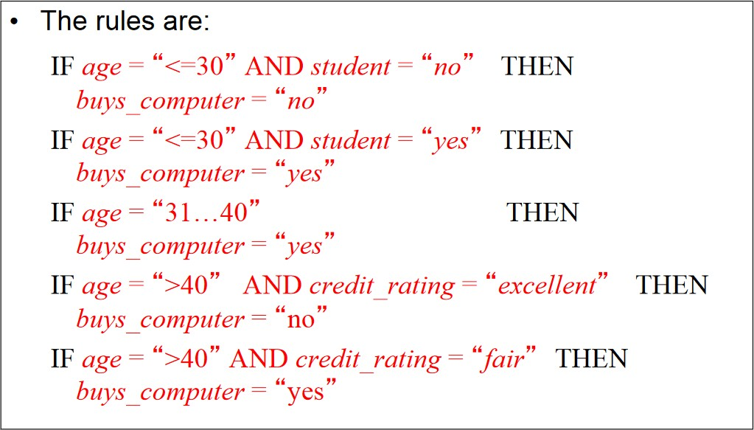
Rules extracted from the tree

Slide 32
Inductive Bias
Shorter trees are preferred over larger trees

Slide 33
Overfitting and Tree Pruning
Overfitting: An induced tree may overfit the training data
Too many branches, some may reflect anomalies due to
noise or outliers
Poor accuracy for unseen samples
Two approaches to avoid overfitting
Prepruning: Halt tree construction early ̵ do not split a node if this would result in the goodness measure falling below a threshold
Difficult to choose an appropriate threshold
Postpruning: Remove branches from a “fully grown” tree—get a sequence of progressively pruned trees
Use a set of data different from the training data to decide which is the “best pruned tree”
33

Slide 34


Attribute Selection Measures
Information gain:
biased towards multivalued attributes
Gain ratio:
tends to prefer unbalanced splits in which one partition is much smaller than the others
34

Slide 35
Gini index:
gini(D) =1−
n
∑
j=1
_{pj}2
where pj is the relative frequency of class j in D
Choose attribute with low gini index
has difficulty when # of classes is large
tends to favor tests that result in equal-sized partitions and purity in both partitions
35

Slide 36
Decision tree suited when -
Instances are represented by attribute-value pairs
The target function has discrete output values
The training data may contain errors.
The training data may contain missing attribute values
36

Slide 37
Thank you
37

